Slide 1
Web Usability Principles
By Mark Kportufe

Slide 2

What Is Web Usability Principles?
Web usability is the one element that makes the difference between an effective website and one that is disregarded without a second thought.

Slide 3
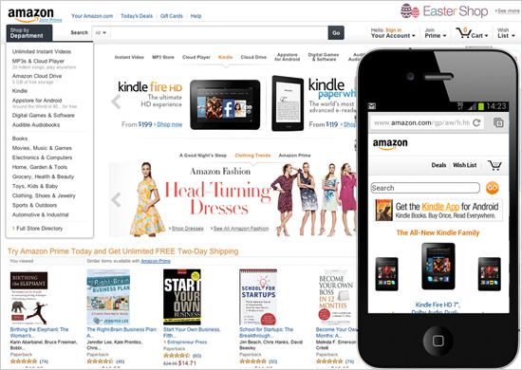
Availability and Accessibility
Server Time Up
It’s important to ensure your visitors don’t get an error trying to load your site. Invest in good hosting.
Broken Links
Double check that there are no dead links on your site.
Mobile Responsiveness
Make sure your site can handle different screen sizes and slow connections.

Slide 4
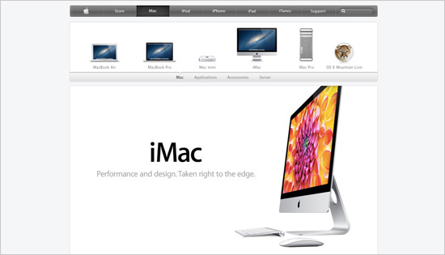
Clarity
Simplicity
Focus on what’s important.
Familiarity
Stick to what people already know.
Guidance
Take your visitors by the hand.
Good Information Architecture
Understand your visitors’ mental models
Consistency
Create a consistent experience across your entire website to keep your visitors mind at ease.
Direct Feedback
Make sure to offer an indication of success or failure of their actions.

Slide 5
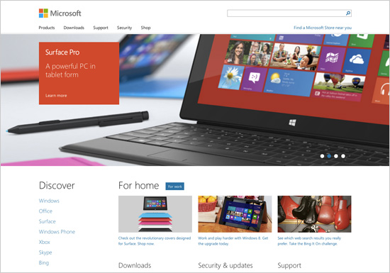
Learnability
It should be your goal to design intuitive interfaces
Keep it simple and visual to help people remember new concepts.

Slide 6

Credibility
Offer a clear “About Us” page together with your contact details.
Show third-party testimonials, work references, or the number of your social media followers to win your visitors over.

Slide 7
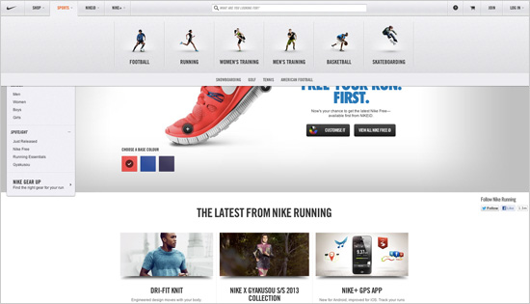
Relevancy
Your content must be relevant.
Define user scenarios
Design decision should result in a more user-friendly website for your users.

Slide 8
Questions?
References
https://wpamelia.com/9-principles-of-web-usability/
https://en.wikipedia.org/wiki/Web_usability
https://medium.com/@tristaljing/5-crucial-principles-of-websites-usability-and-design-47c6786efd3f
https://www.usabilitybok.org/principles-for-usable-design

